Slide 1
Why to Learn Python?
Python is a
High-level, interpreted, interactive and object-oriented scripting language. Python is designed to be highly readable. It uses English keywords frequently whereas other languages use punctuation, and it has fewer syntactical constructions than other languages.
Guido van Rossum was creating python in the 1980s, he made sure to design it to be a general-purpose language. One of the main reasons for the popularity of python would be its simplicity in syntax so that it could be easily read and understood even by the beginner developers also.

Slide 2
Python is Interpreted − Python is processed at runtime by the interpreter. You do not need to compile your program before executing it. This is similar to PERL and PHP.Python is Interactive − You can actually sit at a Python prompt and interact with the interpreter directly to write your programs.
Python is Object-Oriented − Python supports Object-Oriented style or technique of programming that encapsulates code within objects.
Python is a Beginner's Language − Python is a great language for the beginner-level programmers and supports the development of a wide range of applications from simple text processing to WWW browsers to games.

Slide 3
Characteristics of Python
It supports functional and structured programming methods as well as OOP.
It can be used as a scripting language or can be compiled to byte-code for building large applications.
It provides very high-level dynamic data types and supports dynamic type checking.
It supports automatic garbage collection.
It can be easily integrated with C, C++, COM, ActiveX, CORBA, and Java.

Slide 4
Features of Python
Easy-to-learn − Python has few keywords, simple structure, and a clearly defined syntax. This allows the student to pick up the language quickly.
Easy-to-read − Python code is more clearly defined and visible to the eyes.
Easy-to-maintain − Python's source code is fairly easy-to-maintain.
A broad standard library − Python's bulk of the library is very portable and cross-platform compatible on UNIX, Windows, and Macintosh.
Interactive Mode − Python has support for an interactive mode which allows interactive testing and debugging of snippets of code.
Portable − Python can run on a wide variety of hardware platforms and has the same interface on all platforms.

Slide 5
Extendable − You can add low-level modules to the Python interpreter. These modules enable programmers to add to or customize their tools to be more efficient.
Databases − Python provides interfaces to all major commercial databases.
GUI Programming − Python supports GUI applications that can be created and ported to many system calls, libraries and windows systems, such as Windows MFC, Macintosh, and the X Window system of Unix.
Scalable − Python provides a better structure and support for large programs than shell scripting.

Slide 6
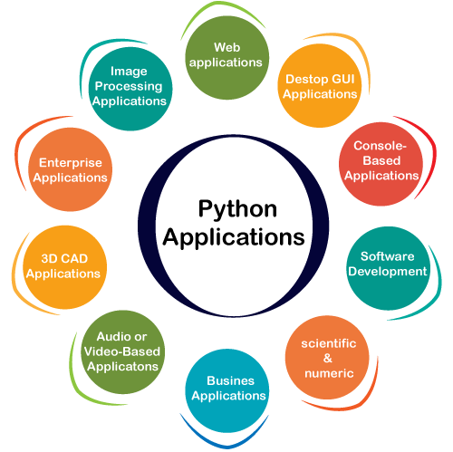
Application of Python

Slide 7
Web Applications
We can use Python to develop web applications. It provides libraries to handle internet protocols such as HTML and XML, JSON, Email processing, request, beautifulSoup, Feedparser, etc. One of Python web-framework named Django is used on Instagram. Python provides many useful frameworks, and these are given below:
Django and Pyramid framework(Use for heavy applications)
Flask and Bottle (Micro-framework)
Plone and Django CMS (Advance Content management)
2) Desktop GUI Applications
The GUI stands for the Graphical User Interface, which provides a smooth interaction to any application. Python provides a Tk GUI library to develop a user interface. Some popular GUI libraries are given below.
Tkinter or Tk
wxWidgetM
Kivy (used for writing multitouch applications )
PyQt or Pyside

Slide 8
3) Console-based Application
Console-based applications run from the command-line or shell. These applications are computer program which are used commands to execute. This kind of application was more popular in the old generation of computers. Python can develop this kind of application very effectively. It is famous for having REPL, which means the Read-Eval-Print Loop that makes it the most suitable language for the command-line applications.
4) Software Development
Python is useful for the software development process. It works as a support language and can be used to build control and management, testing, etc.
SCons is used to build control.
Buildbot and Apache Gumps are used for automated continuous compilation and testing.
Round or Trac for bug tracking and project management.
5) Scientific and Numeric
This is the era of Artificial intelligence where the machine can perform the task the same as the human. Python language is the most suitable language for Artificial intelligence or machine learning. It consists of many scientific and mathematical libraries, which makes easy to solve complex calculations.
Implementing machine learning algorithms require complex mathematical calculation. Python has many libraries for scientific and numeric such as Numpy, Pandas, Scipy, Scikit-learn, etc. If you have some basic knowledge of Python, you need to import libraries on the top of the code. Few popular frameworks of machine libraries are given below.
SciPy
Scikit-learn
NumPy
Pandas
Matplotlib

Slide 9
6) Business Applications
Business Applications differ from standard applications. E-commerce and ERP are an example of a business application. This kind of application requires extensively, scalability and readability, and Python provides all these features.
Oddo is an example of the all-in-one Python-based application which offers a range of business applications. Python provides a Tryton platform which is used to develop the business application.
7) Audio or Video-based Applications
Python is flexible to perform multiple tasks and can be used to create multimedia applications. Some multimedia applications which are made by using Python are TimPlayer, cplay, etc. The few multimedia libraries are given below.
Gstreamer
Pyglet
QT Phonon
8) 3D CAD Applications
The CAD (Computer-aided design) is used to design engineering related architecture. It is used to develop the 3D representation of a part of a system. Python can create a 3D CAD application by using the following functionalities.
Fandango (Popular )
CAMVOX
HeeksCNC
AnyCAD
RCAM

Slide 10
9) Enterprise Applications
Python can be used to create applications that can be used within an Enterprise or an Organization. Some real-time applications are OpenERP, Tryton, Picalo, etc.
10) Image Processing Application
Python contains many libraries that are used to work with the image. The image can be manipulated according to our requirements. Some libraries of image processing are given below.
OpenCV
Pillow
SimpleITK
In this topic, we have described all types of applications where Python plays an essential role in the development of these applications. In the next tutorial, we will learn more concepts about Python.

Slide 11
Installation of Python
Steps to install on Windows:
Open the official python website www.python.org and click the Download Python button
Follow the on-screen instructions to install with the IDLE editor
Open the command prompt/terminal and check the version using
python -V

Slide 12
Steps to install on Mac OS X:
Open the official python website www.python.org and click the Download Python button
Follow the on-screen instructions to install with the IDLE editor
Open the command prompt/terminal and check the version using
python3 -V
Steps to install on Linux:
Ubuntu and various Linux distributions are bundled with python3

Slide 13
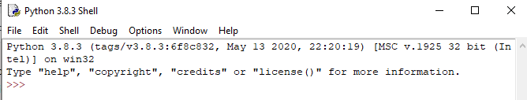
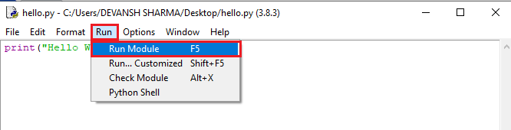
Working in Python
Once you have Python installed on your system, you are ready to work on it. You can work
in Python in two different modes:-
a) Interactive Mode: In this mode, you type one command at a time and Python
executes the same. Python’s interactive interpreter is also called Python Shell.
b) Script Mode: In this mode, we save all our commands in the form of a program file
and later run the entire script. After running the script, the whole program gets
compiled and you’ll see the overall output.

Slide 14
First Program
Name=‘Akash’
Print(Name)

Slide 15
Multiline Statements
name = "Andrew Venis"
branch = "Computer Science"
age = "25"
print("My name is: ", name, )
print("My age is: ", age)
The end of a statement in python is denoted with a newline character (‘\n’).
But if we wish to continue our statement we can do so with the line continuation character(\).

Slide 16
Comments in Python
Comments play a vital role in developing programs as they help by providing information to the reader to understand the source code developed by the developer. These are lines or statements that explain a particular logic or part of the code.
There are two types of comments that can be provided in programming
Single line comments
#This is a comment
Multiple line comments
"""
This is a comment
written in
more than just one line
"""

Slide 17
Python Identifiers
Python identifiers refer to a name used to identify a variable, function, module, class, module or other objects. There are few rules to follow while naming the Python Variable.
A variable name must start with either an English letter or underscore (_).
A variable name cannot start with the number.
Special characters are not allowed in the variable name.
The variable's name is case sensitive.

Slide 18
Python Variables
Variable is a name that is used to refer to memory location. Python variable is also known as an identifier and used to hold value.
In Python, we don't need to specify the type of variable because Python is a infer language and smart enough to get variable type.
Variable names can be a group of both the letters and digits, but they have to begin with a letter or an underscore.
It is recommended to use lowercase letters for the variable name. Rahul and rahul both are two different variables.
Identifier Naming
Variables are the example of identifiers. An Identifier is used to identify the literals used in the program. The rules to name an identifier are given below.
The first character of the variable must be an alphabet or underscore ( _ ).
All the characters except the first character may be an alphabet of lower-case(a-z), upper-case (A-Z), underscore, or digit (0-9).
Identifier name must not contain any white-space, or special character (!, @, #, %, ^, &, *).
Identifier name must not be similar to any keyword defined in the language.
Identifier names are case sensitive; for example, my name, and MyName is not the same.
Examples of valid identifiers: a123, _n, n_9, etc.
Examples of invalid identifiers: 1a, n%4, n 9, etc.

Slide 19
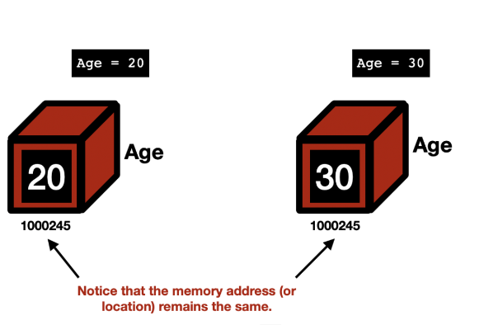
Traditional Programming Languages’ Variables in Memory

Slide 20
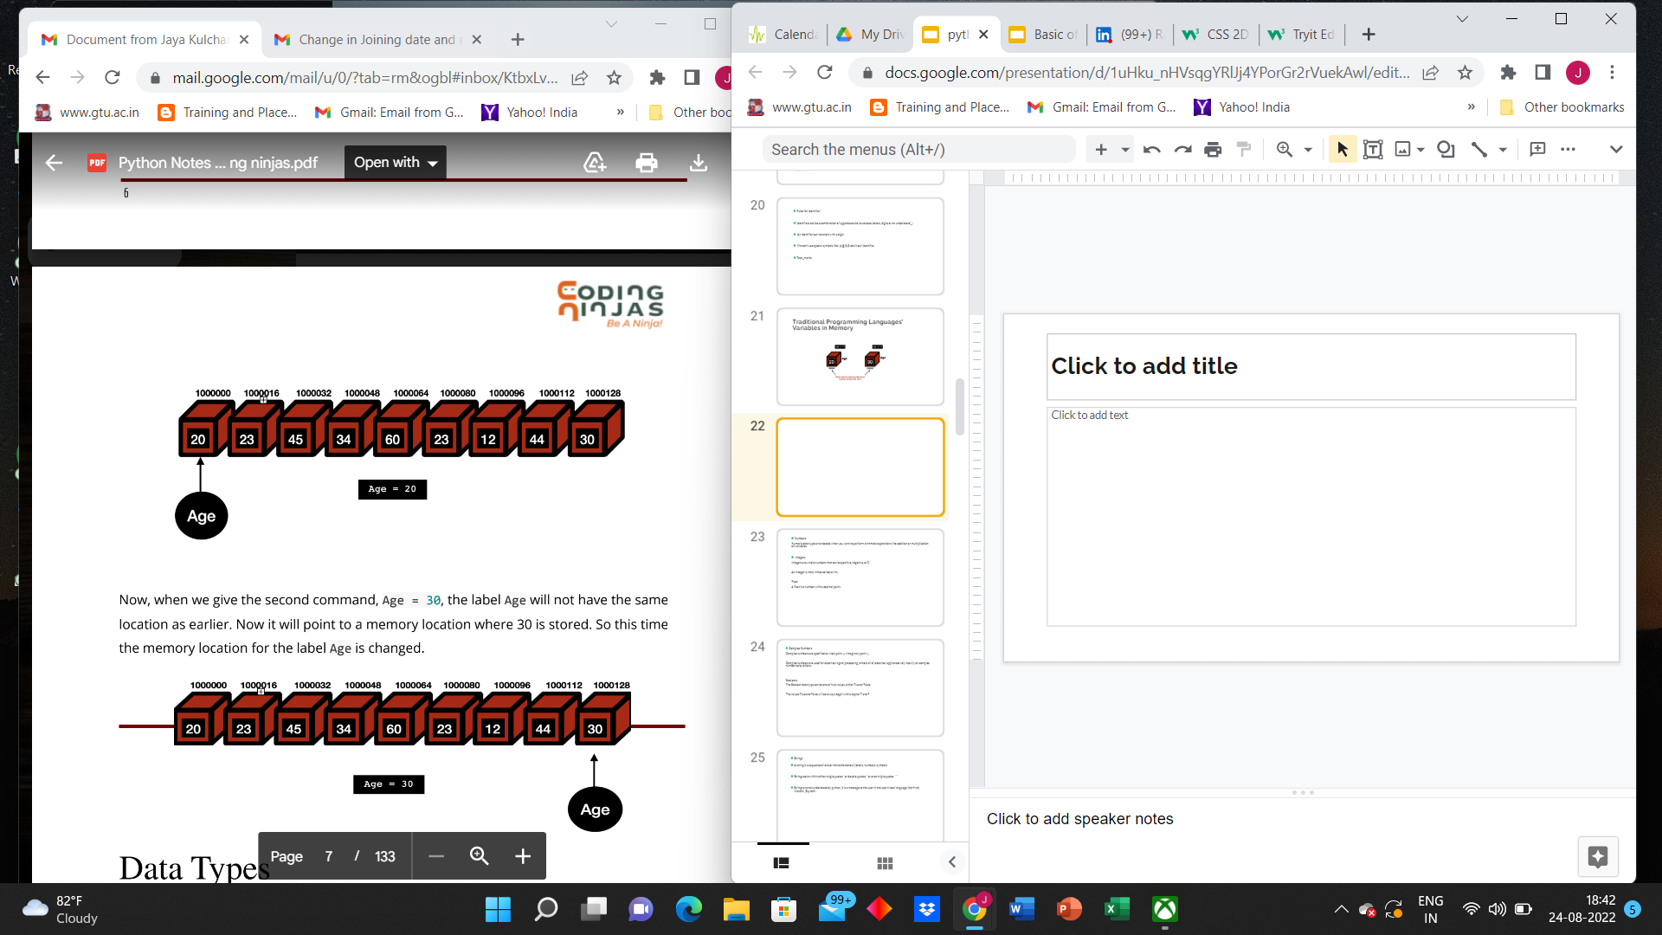
Python Variables in Memory

Slide 21
Examples of variables in real world:
Temperature_of_ Room
Age
Cricket Score
Marks in exams

Slide 22
Declaring a variable in python:
name = “itvedant”
age = 23
perc = 93.5

Slide 23
Now let us create a variable namely Student to hold a student’s name and a
variable Age to hold a student’s age.
>>> Student = "Jacob"
>>> Age = 19
Python will internally create labels referring to these values as shown below:
greeting = "Hello, World!"
print(greeting)
Here, the Python program assigned the value of the string to a variable greeting, and
then when we call print(greeting), it prints the value that the variable, greeting, points
to i.e. "Hello, World!"
We get the output as:-
Hello, World!

Slide 24
1. Assigning single value to multiple variables
Eg:
x=y=z=50
print(x)
print(y)
print(z)
Output:
50
50
50
2. Assigning multiple values to multiple variables:
Eg:
a,b,c=5,10,15
print a
print b
print c

Slide 25
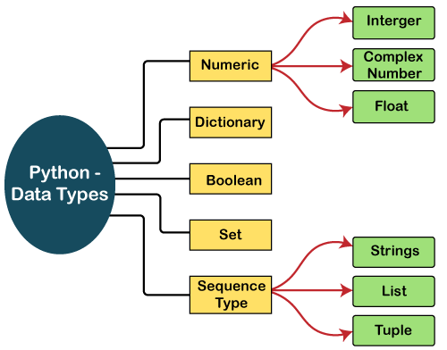
Data Types
Data types are the classification or categorization of data items. Data types represent a kind of value that determines what operations can be performed on that data. Numeric, non-numeric, and Boolean (true/false) data are the most used data types. However, each programming language has its classification largely reflecting its programming philosophy. Python offers the following built-in data types:

Slide 26
Python supports three types of numeric data.
Int - Integer value can be any length such as integers 10, 2, 29, -20, -150 etc. Python has no restriction on the length of an integer. Its value belongs to int
Float - Float is used to store floating-point numbers like 1.9, 9.902, 15.2, etc. It is accurate upto 15 decimal points.
complex - A complex number contains an ordered pair, i.e., x + iy where x and y denote the real and imaginary parts, respectively. The complex numbers like 2.14j, 2.0 + 2.3j, etc.
Sequence Type : String
The string can be defined as the sequence of characters represented in the quotation marks. In Python, we can use single, double, or triple quotes to define a string.
String handling in Python is a straightforward task since Python provides built-in functions and operators to perform operations in the string.
In the case of string handling, the operator + is used to concatenate two strings as the operation "hello"+" python" returns "hello python".
The operator * is known as a repetition operator as the operation "Python" *2 returns 'Python Python'.
str = "string using double quotes"
print(str)
s = '''''A multiline
string'''
print(s)

Slide 27
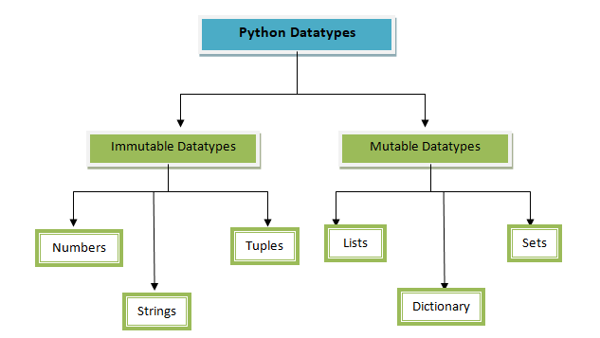

Slide 28
str1 = 'hello javatpoint' #string str1
str2 = ' how are you' #string str2
print (str1[0:2]) #printing first two character using slice operator
print (str1[4]) #printing 4th character of the string
print (str1*2) #printing the string twice
print (str1 + str2) #printing the concatenation of str1 and str2
Boolean
Boolean type provides two built-in values, True and False. These values are used to determine the given statement true or false. It denotes by the class bool. True can be represented by any non-zero value or 'T' whereas false can be represented by the 0 or 'F'. Consider the following example.
# Python program to check the boolean type
print(type(True))
print(type(False))
print(false)

Slide 29
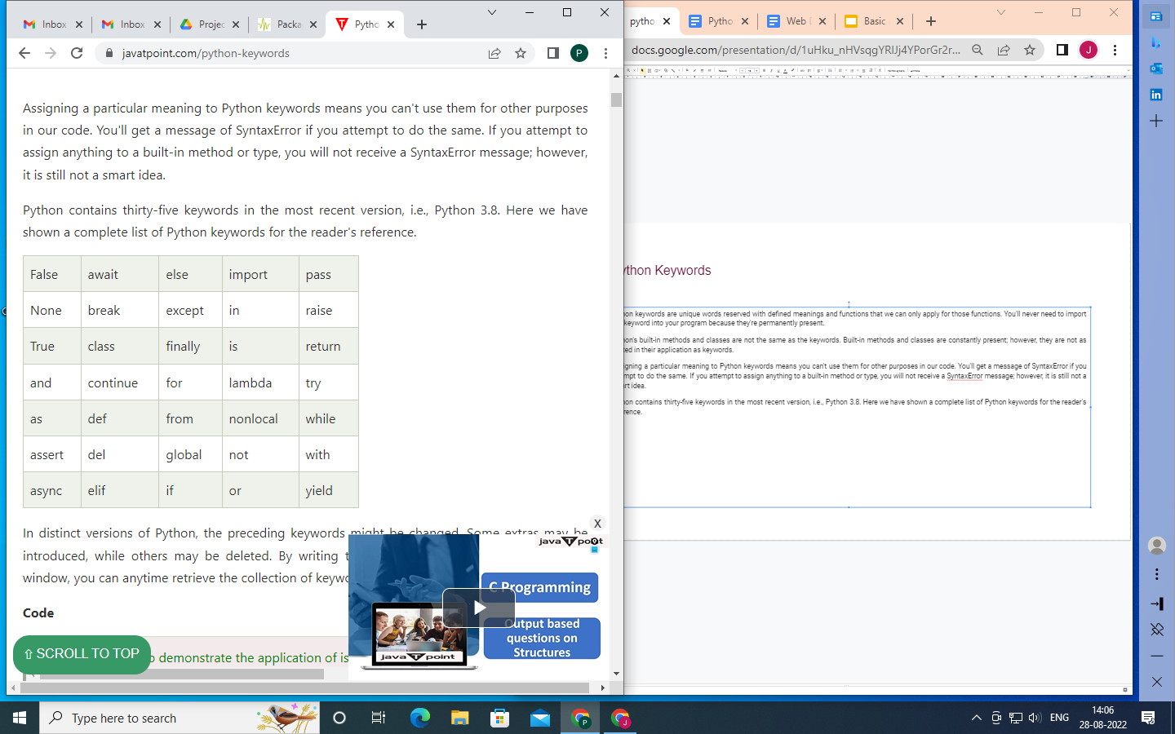
Python Keywords
Python keywords are unique words reserved with defined meanings and functions that we can only apply for those functions. You'll never need to import any keyword into your program because they're permanently present.
Python's built-in methods and classes are not the same as the keywords. Built-in methods and classes are constantly present; however, they are not as limited in their application as keywords.
Assigning a particular meaning to Python keywords means you can't use them for other purposes in our code. You'll get a message of SyntaxError if you attempt to do the same. If you attempt to assign anything to a built-in method or type, you will not receive a SyntaxError message; however, it is still not a smart idea.
Python contains thirty-five keywords in the most recent version, i.e., Python 3.8. Here we have shown a complete list of Python keywords for the reader's reference.

Slide 30
Python Operators
The operator can be defined as a symbol which is responsible for a particular operation between two operands. Operators are the pillars of a program on which the logic is built in a specific programming language. Python provides a variety of operators, which are described as follows.
Arithmetic operators
Comparison operators
Assignment Operators
Logical Operators
Bitwise Operators
Membership Operators
Identity Operators

Slide 31
Operator | Meaning | Example
+ | Add two operands or unary plus | x + y+ 2
- | Subtract right operand from the left or unary minus | x - y- 2
* | Multiply two operands | x * y
/ | Divide left operand by the right one (always results into float) | x / y
% | Modulus - remainder of the division of left operand by the right | x % y (remainder of x/y)
// | Floor division - division that results into whole number adjusted to the left in the number line | x // y
** | Exponent - left operand raised to the power of right | x**y (x to the power y)

Slide 32
In[] : print(5 + 2) # Addition
Out[] : 7
In[] : print(5 - 2) # Subtraction
Out[] : 3
In[] : print(5 * 2) # Multiplication
Out[] : 10
In[] : print(5 / 2) # Floating Point Division
Out[] : 2.5
In[] : print(5 // 2) # Floor Division
Out[] : 2 # 5 divided by 2 gives 2.5 and value of floor(2.5) is 2
In[] : print(5 ** 2) # Calculate Exponent
Out[] : 25 # 5 raised to the power of 2 is 25
In[] : print(5 % 2) # Modulus
Out[] : 1 # Remainder 1 is left after dividing 5 by 2

Slide 33
How to take User Input?
To get the input from the user interactively, we can use the built-in function, input(). This
function is used in the following manner:
variable_to_hold_the_input_value = input(<Prompt to be displayed>)
Note:- input() function always returns a value of the String type. Notice that in the
above script the output for both name and age, Python has enclosed the output in quotes,
like 'Rishabh' and '19', which implies that it is of String type. This is just because,
whatever the user inputs in the input() function, it is treated as a String. This would
mean that even if we input an integer value like 20, it will be treated like a string '19' and
not an integer.

Slide 34
In[] : age = input("What is your age?")
The above statement will display the prompt as:-
What is your age?________ ←{User input here}
We will get the following interactive output:
In[] : name = input("Enter your name: ")
Enter your name: Rishabh #User Input
In[] : age = input("Enter your age: ")
Enter your age: 20 #User Input
In[] : name
Out[] : 'Rishabh'
In[] : age
Out[] : '19'

Slide 35
Reading Numbers
Python offers two functions int() and float() to be used with the input() function to
convert the values received through input() into the respective numeric types integer and
floating-point numbers. The steps will be:-
1. Use the input() function to read the user input.
2. Use the int() and float() function to convert the value read into integers and
floating-point numbers, respectively. This process is called Type Casting.
The general way of taking Input:
variableRead = input(<Prompt to be displayed>)
updatedVariable = int(variableRead)
Here, variableRead is a String type that was read from the user. This string value will then
be converted to Integer using the int() function and assigned to updatedVariable.
This can even be shortened to a single line of code as shown below:-
updatedVariable = int(input(<Prompt to be displayed>))

Slide 36
In[] : age= int(input("Enter Your Age: "))
Enter Your Age: 19
In[] : age
Out[] : 19
Here, the output will be 19 and not '19', i.e. the output is an Integer and not a String.
Similarly, if we want to read a floating-point number, we can do the following:-
In[] : weight= float(input("Enter Your Age: "))
Enter Your Weight: 65.5
In[] : weight
Out[] : 65.5

Slide 37
Boolean Data Type
A boolean expression (or logical expression) evaluates to one of the two states - True or
False. Several functions and operations in Python return boolean objects.
The assignment of boolean datatype to some variable can be done similar to other data
types. This is shown as follows:-
>>> a = True
>>> type(a)
<class 'bool'>
>>> b = False
>>> type(b)
<class 'bool'>

Slide 38
Note:- Here True and False are Reserved keywords. ie They are not written as "True" or
"False", as then they will be taken as strings and not boolean values.
C = "True"
D = "False"
Here, C and D are of type String.
Also, note the keywords True and False must have an Upper Case first letter. Using a
lowercase true or false will return an error.
>>> e = true
Traceback (most recent call last):
File "<input>", line 1, in <module>
NameError: name 'true' is not defined

Slide 39
Comparison Operator
Operator | Meaning | Example
> | Greater than - True if left operand is greater than the right | x > y
< | Less than - True if left operand is less than the right | x < y
== | Equal to - True if both operands are equal | x == y
!= | Not equal to - True if operands are not equal | x != y
>= | Greater than or equal to - True if left operand is greater than or equal to the right | x >= y
<= | Less than or equal to - True if left operand is less than or equal to the right | x <= y

Slide 40
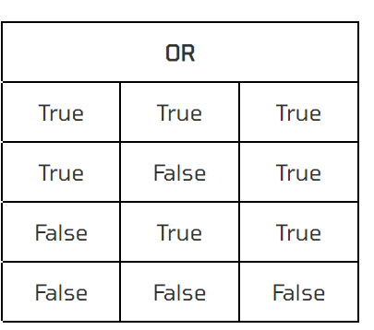
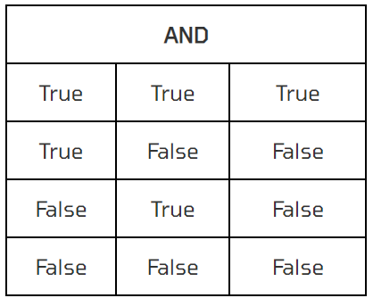
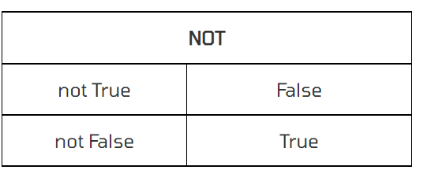
Logical Operator
and
or
not

Slide 41
Bitwise Operators
The bitwise operators perform bit by bit operation on the values of the two operands. Consider the following example.
In the table below: Let x = 10 (0000 1010 in binary) and y = 4 (0000 0100 in binary)
Operator | Meaning | Example
& | Bitwise AND | x & y = 0 (0000 0000)
| | Bitwise OR | x | y = 14 (0000 1110)
~ | Bitwise NOT | ~x = -11 (1111 0101)
^ | Bitwise XOR | x ^ y = 14 (0000 1110)
>> | Bitwise right shift | x >> 2 = 2 (0000 0010)
<< | Bitwise left shift | x << 2 = 40 (0010 1000)

Slide 42
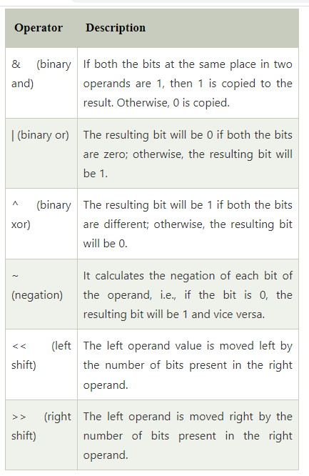

Slide 43
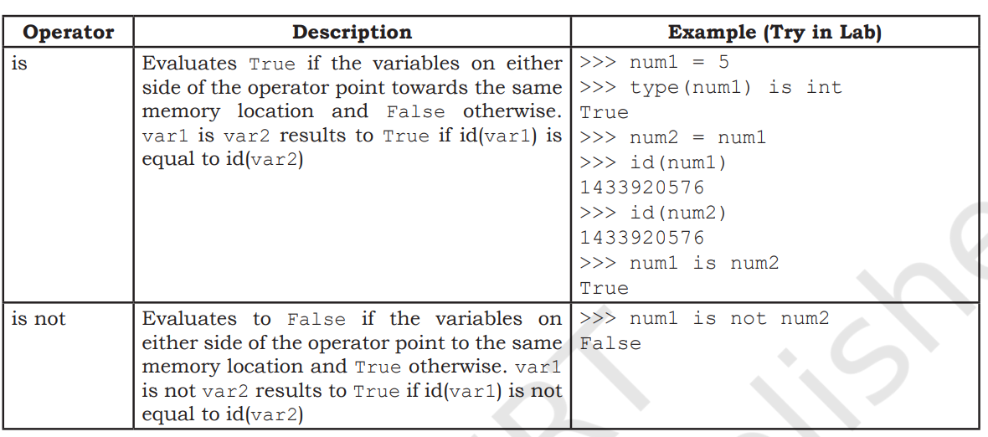
Identity Operator

Slide 44
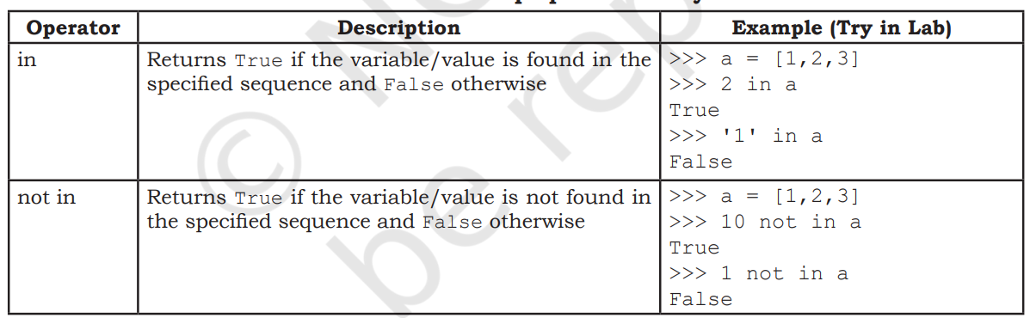
Membership Operator

Slide 45
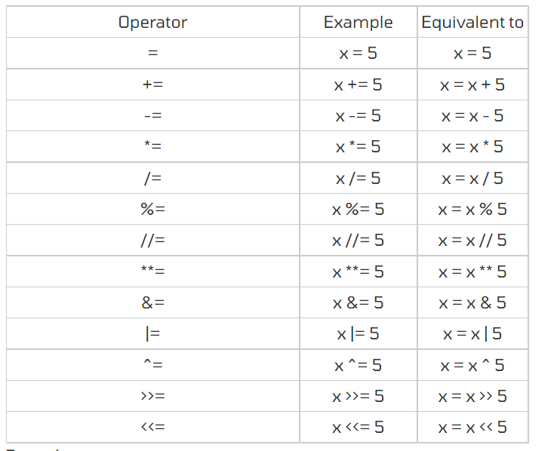

Slide 46
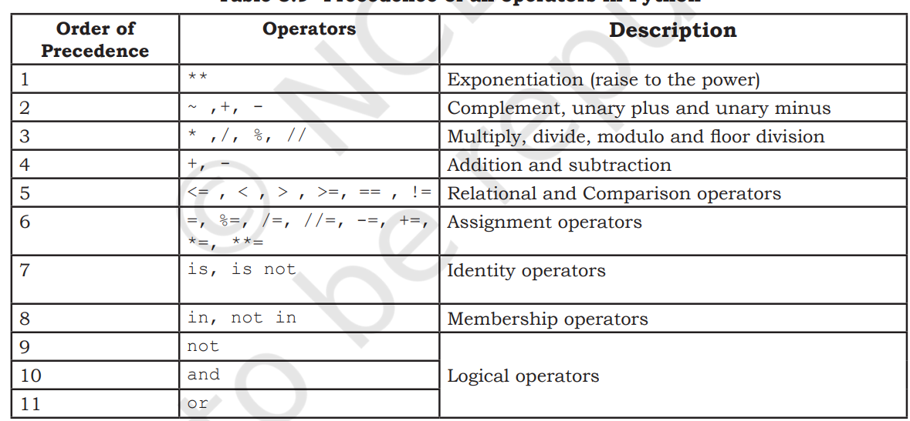

Slide 47
Write a Python program to find the area of a rectangle given that its length is 10 units
Write a Python program to convert temperature in degree Celsius to degree Fahrenheit. If water boils at 100 degree C and freezes as 0 degree C, use the program to find out what is the boiling point and freezing point of water on the Fahrenheit scale. (Hint: T(°F) = T(°C) × 9/5 + 32
Python Program to Swap Two Variables

Slide 48
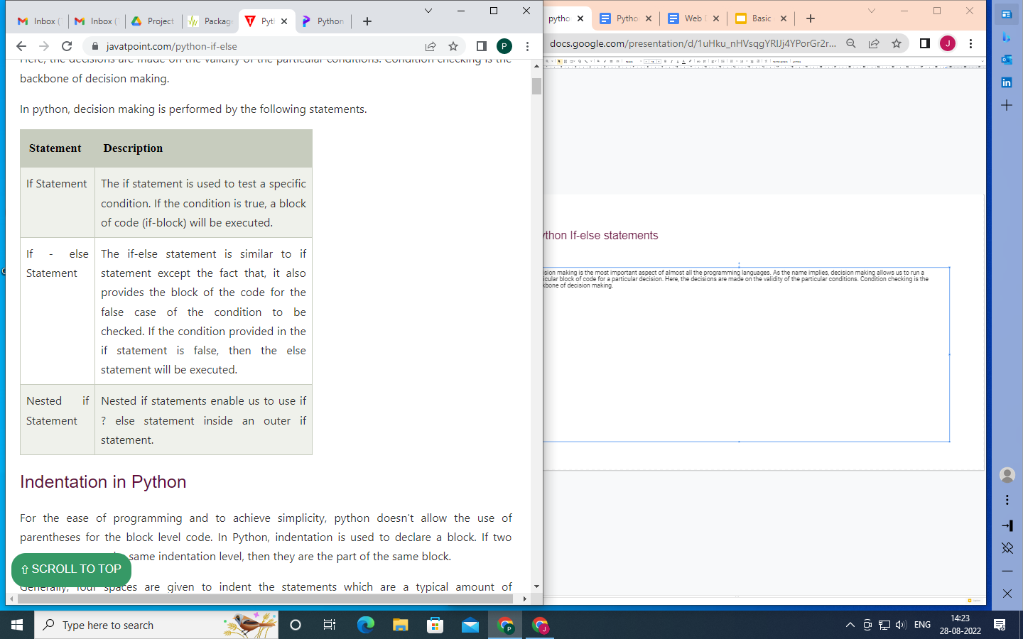
Python If-else statements
Decision making is the most important aspect of almost all the programming languages. As the name implies, decision making allows us to run a particular block of code for a particular decision. Here, the decisions are made on the validity of the particular conditions. Condition checking is the backbone of decision making.

Slide 49
The syntax of the if-statement is given below.
if expression:
statement
Example :
num = int(input("enter the number?"))
if num%2 == 0:
print("Number is even")
The syntax of the if-else statement is given below.
if condition:
#block of statements
else:
#another block of statements (else-block)
Example :
age = int (input("Enter your age? "))
if age>=18:
print("You are eligible to vote !!");
else:
print("Sorry! you have to wait !!");

Slide 50
The syntax of the elif statement is given below.
if expression 1:
# block of statements
elif expression 2:
# block of statements
elif expression 3:
# block of statements
else:
# block of statements
Example :
number = int(input("Enter the number?"))
if number==10:
print("number is equals to 10")
elif number==50:
print("number is equal to 50");
elif number==100:
print("number is equal to 100");
else:
print("number is not equal to 10, 50 or 100");

Slide 51
Program to check if the given number is divisible by 3 or 7.
Program to find the larger of the three pre-specified numbers
Python program to check Prime Number in range of 1 to 20.
Python program to calculate the number of notes for 5520 rs.
Write a program that accepts the age of candidate and print the messages based on the age.
1)Age < 18
print message : Your Minor so not eligible to work
2) Age >18 and Age <60
Collect all the details from candidate like name, phoneno email and print it as output
3) Age > 60
print message : You are too old to work please collect the pension
6. program to input electricity unit charges and calculate total electricity bill according to the given condition:
For first 50 units Rs. 0.50/unit
For next 100 units Rs. 0.75/unit
For next 100 units Rs. 1.20/unit
For unit above 250 Rs. 1.50/unit
An additional surcharge of 20% is added to the bill

Slide 52
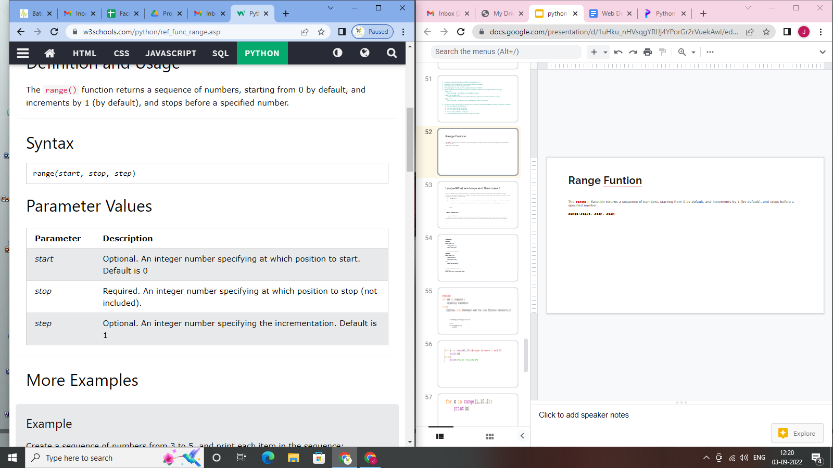
Range Funtion
The range() function returns a sequence of numbers, starting from 0 by default, and increments by 1 (by default), and stops before a specified number.
range(start, stop, step)

Slide 53
x = range(6)
So X will have values 0,1,2,3,4,5
x = range(3, 6)
So X will have values 3,4,5
x = range(3, 20, 2)
So x will have 3,5,7,9,11,13,15,17,19

Slide 54
Loops-What are loops and their uses ?
Python programming language provides the following types of loops to handle looping requirements. Python provides three ways for executing the loops. While all the ways provide similar basic functionality, they differ in their syntax and condition checking time.
While Loop:
In python, while loop is used to execute a block of statements repeatedly until a given condition is satisfied. And when the condition becomes false, the line immediately after the loop in the program is executed.
Syntax :
while expression:
statement(s)
All the statements indented by the same number of character spaces after a programming construct are considered to be part of a single block of code. Python uses indentation as its method of grouping statements.

Slide 55
# while loop
count = 0
while (count < 3):
count = count + 1
print("Hello Geek")
# combining else with while
count = 0
while (count < 3):
count = count + 1
print("Hello Geek")
else:
print("In Else Block")
# Single statement while block
count = 0
while (count == 0): print("Hello Geek")

Slide 56
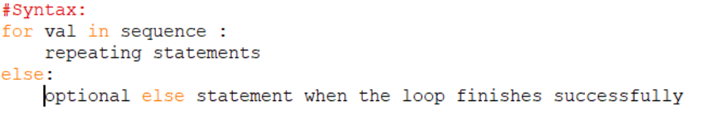
For Loop
# Iterating over range 0 to n-1
n = 4
for i in range(0, n):
print(i)

Slide 57
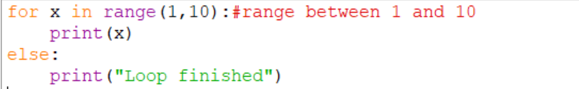


Slide 58
# Iterating over a list
print("List Iteration")
l = ["geeks", "for", "geeks"]
for i in l:
print(i)
# Iterating over a tuple (immutable)
print("\nTuple Iteration")
t = ("geeks", "for", "geeks")
for i in t:
print(i)
# Iterating over a String
print("\nString Iteration")
s = "Geeks"
for i in s :
print(i)
# Iterating over dictionary
print("\nDictionary Iteration")
d = dict()
d['xyz'] = 123
d['abc'] = 345
for i in d :
print("%s %d" %(i, d[i]))
#Iterating over a set
print("\nSet Iteration")
set1 = {1,2,3,4,5,6}
for i in set1:
print(i)

Slide 59
Nested Loop
When we have a Loop inside another loop is called as Nested loop.
Example:
for i in range(1,4,1):
print(i,"=>",end="")
for j in range(1,5,1):
print(j,end=" ")
print()

Slide 60
In above example j loop is nested inside the i loop. i loop is called as the outer loop and j loop is called a inner loop.
In execution, for a single iteration of outer loop, inner loop execute n times which depend upon the inner loop condition.

Slide 61
Loop Control Statement
Loop Control Statements: Loop control statements change execution from their normal sequence. When execution leaves a scope, all automatic objects that were created in that scope are destroyed. Python supports the following control statements.
Continue Statement: It returns the control to the beginning of the loop.
for letter in 'geeksforgeeks':
if letter == 'e' or letter == 's':
continue
print ('Current Letter :', letter)
var = 10
Current Letter : g
Current Letter : k
Current Letter : f
Current Letter : o
Current Letter : r
Current Letter : g
Current Letter : k

Slide 62
Break->
Break is used to exit the loop before the condition of the loop turns false.
It prematurely terminates the loop often using a base condition using if.
break is utmost important to exit the otherwise never-ending infinite loop.
The else part is not executed if the loop exits with break

Slide 63
Break Statement: It brings control out of the loop
for letter in 'geeksforgeeks':
# break the loop as soon it sees 'e'
# or 's'
if letter == 'e' or letter == 's':
break
print 'Current Letter :', letter

Slide 64
#Program to demonstrate the use of break statement in loop
num = 0
for num in range(10):
num = num + 1
if num == 8:
break
print('Num has value ' + str(num))
print('Encountered break!! Out of loop')

Slide 65
Pass Statement: We use pass statement to write empty loops. Pass is also used for empty control statements, functions and classes.
# An empty loop
for letter in 'geeksforgeeks':
pass
print 'Last Letter :', letter

Slide 66
Write a program to print first 10 even numbers in reverse order.
Write a program to display product of the digits of a number accepted from the user.
Print multiplication table of 24
Take integer inputs from user until he/she presses q ( Ask to press q to quit after every integer input ). Print average and product of all numbers.
program in Python to make such a pattern like a pyramid with numbers increased by 1.
1
2 3
4 5 6
7 8 9 10
Pattern Program
1
212
32123
4321234
543212345
program in Python to display the n terms of harmonic series and their sum.
1 + 1/2 + 1/3 + 1/4 + 1/5 ... 1/n terms
Test Data :
Input the number of terms : 5
Expected Output :
1/1 + 1/2 + 1/3 + 1/4 + 1/5 +
Sum of Series upto 5 terms : 2.283334

